Slide 1
Public Meeting
P 0010(163)182 & P 1804(53)391 PCN 07C8 & 07C9 S.D. Highway 10 (Main Str.)
and S.D. Highway 1804 (Summit Ave. and B Ave.)
in Pollock, SD
Richard Sudmeier, PE
Design Project Manager
March 12, 2024
Notes:
Good evening and welcome to the Public Meeting to discuss planned ADA improvements to SD Highways 1804 & 10.
My name is Richard Sudmeier with FMG Engineering in Rapid City on Behalf of the SDDOT.
Also here from FMG Engineering is:
Charles Davidson, one of our engineers.
Representing the SDDOT, we have:
Sam Gilkerson, Consultant Manager Engineer, Pierre
John Villbrandt, Area Engineer, Mobridge
Hopefully everyone had a chance to sign in and picked up a handout. Included in the handout is the power point of which you may follow along.

Slide 2
Purpose of the Meeting
Involve the public in the planning and design process
Provide a Project Overview
Background Information
Proposed Project
Project Schedule
Gather Input and Comments
Notes:
We are here tonight to involve the public in the design process. We would also like to share with you the project scope, what the current design layout is, and the schedule. After the presentation we want to gather public input in the form of exchange of ideas and/or discuss any concerns you may have.

Slide 3
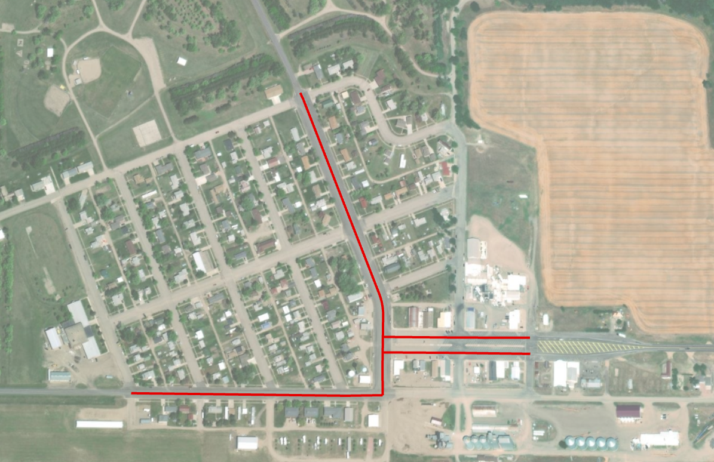
Project Limits
End Project
C Ave
SD Hwy 1804
D Ave
E Ave
End Project
Park St
Oahe St
Begin Project
City of Pollock
SD Hwy 10
SD Hwy 1804
Notes:
The proposed project includes sidewalk work parallel to the red lines shown above. More specifically,he project work area begins on SD 1804 at the intersection of F Ave, continues along SD 1804 until the intersection of B Ave. The project turns north and continues along SD 1804 until Lakeview Dr. The project also includes work on SD 10 beginning at the intersection with SD 1804 and ending after 2 blocks to the East.

Slide 4
Background Information
Last Surface Improvements in 2002 and 2018
2013– Curb Ramp Upgrades
Notes:
There have been several previous projects in the same area as the current project. The roads were largely originally constructed in the 50’s and 60’s with some resurfing projects that occurred around 2002 and 2018. In 2013 the curb ramps along Highways 1804 and 10 were upgraded/installed.

Slide 5
Purpose of the Project
Improve Safety and Ensure ADA Compliance of Pedestrian Facilities / Sidewalks
Notes:
Significant portions of the existing sidewalk in the City of Pollock are not compliant with ADA Standards. Complying with these standards encourages safety and ADA for pedestrians in public areas.

Slide 6
Proposed Improvements
Reconstruct Deteriorated Sidewalks and S.D. Highway 10 Median
Widen Sidewalks to 5’ (Typical)
Correct Sidewalk Ramps not Currently Compliant with ADA Standards
Some Curb and Gutter and Driveway Approach Reconstruction will be Necessary
Notes:
The primary focus of the project is to correct all sidewalk not currently in ADA compliance. The largest focus will be widening of sidewalk and some repair of deficient sidewalk ramps. The correction of sidewalk will require the improvement of several driveway approach as well as curb and gutter.

Slide 7
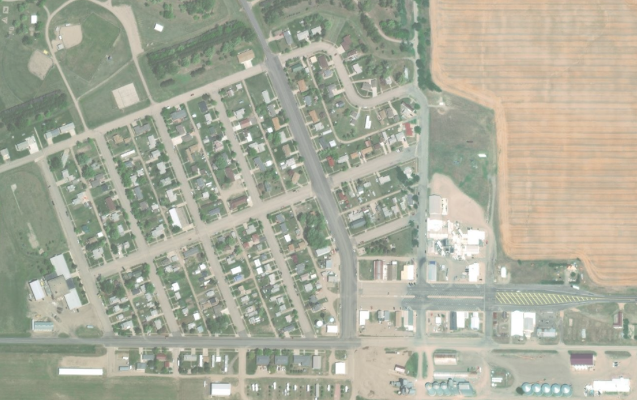
Proposed Pedestrian Facilities
SD Hwy 1804
C Ave
D Ave
E Ave
Park St
Oahe St
City of Pollock
SD Hwy 10
SD Hwy 1804
Notes:
As shown in red, ADA pedestrian facilities are proposed on both sides of SD Hwy 1804 from F Ave to Lakeview Dr. On SD Hwy 10, ADA pedestrian facilities will also be located at
On US 83, a sidewalk with a 15’ boulevard will be added on the west side of the highway. The sidewalk will start at the entrance to TC Elementary School and continue north to the US 18/83 intersection.

Slide 8
Access Management
Manage location and number of access points
Provide safe, efficient access to streets and highways
Review
Relocating, combining and eliminating access points
See Handout
Notes:
Any time SDDOT reconstructs a roadway, we evaluate Access Management. The purpose of access management is to ensure there is safe, efficient ways to access highways not only now but in the future as traffic volumes grow and developments get more dense. Studies have shown that by controlling the access of vehicles to highways, accident rates are decreased. Existing approaches will generally be left in place except where they can be combined with another approach or eliminated if they are not being used. An approach is a hazard itself. Crashes including some fatal crashes can involve vehicles launched by an approach, the elimination or minimizing approaches removes the hazard from the ROW.
The goal is to reduce the number of access points along the route, thereby making the route safer.
If there are proposed changes to accesses, this will be discussed during the landowner meetings. While always a difficult subject, design will work with the property owners as best we can to come up with solutions.
More information on access management is available in the handout.

Slide 9
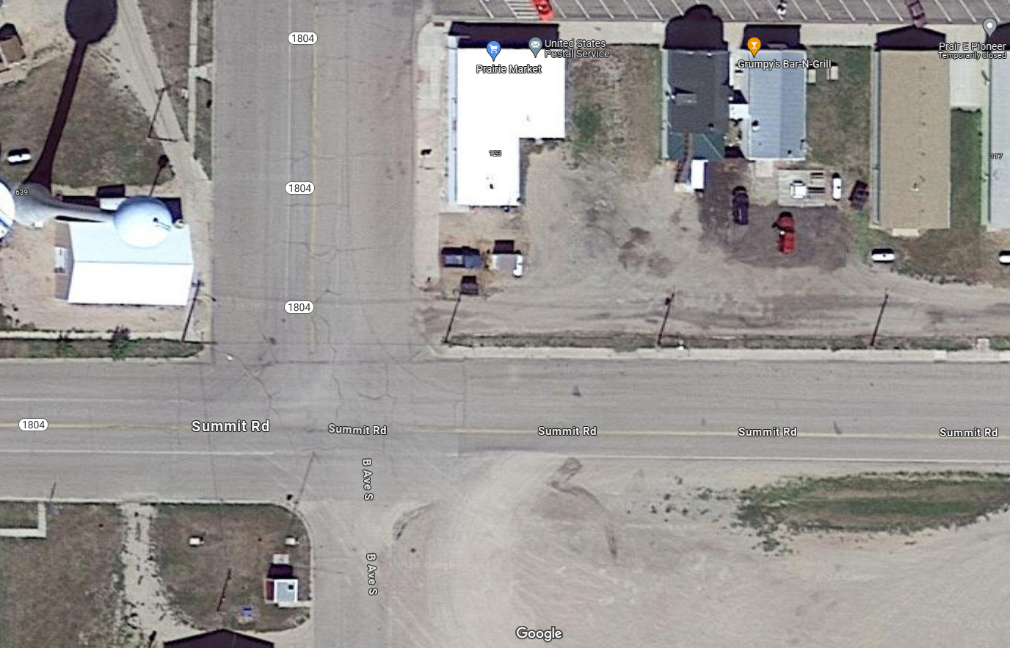
Access Management
B Ave and Summit – NE Corner
Remove Commercial
Entrance and connect sidewalk
New Commercial
Entrance Location
Notes:
For this project, there is one proposed change of access. Specifically, the proposed change is to relocate the commercial entrance at the Northeast corner of the B Ave and Summit Rd intersection. The commercial entrance will be moved to Summit Rd. The reason for this change is to improve pedestrian access across on B Ave and improve drainage.

Slide 10
Right of Way (ROW)
Existing Right-of-Way Width varies from 100-174 feet
Additional Permanent Right-of-Way will not be Necessary
Temporary Easements as needed for Construction
See Handout
Notes:
The existing ROW width for each road segment varies from 100-174 feet.
Temporary easements are necessary whenever the construction work limits are outside of the right of way. Temporary easement allows construction to occur beyond the ROW during construction of the highway. When the limits of work is near or outside the ROW line temporary easements will need to be obtained by the State.
ROW and Temporary Easements will be discussed in more detail during Individual Landowner Meetings, and more information on the right of way process is available in the handout.

Slide 11
Encroachments
Private Property in Public ROW
Examples
Signs
Private Use (Parking)
Landscaping Items
Notification
Federal Highway Regulations for Safety
Owners of Encroachments will be notified by the Mobridge Area Office
See Handout

Slide 12
Utility Coordination
Montana-Dakota Utilities Co.
Valley Telecommunications
City of Pollock
Some Utilities may need to be relocated
Utility Companies negotiate easements with landowners
See Handout

Slide 13
Utility Coordination
Water Lines
Sprinkler Systems
Drain Fields
Septic Tanks
Underground Storage Tanks
Underground Power Lines
Any Known Private Utilities?
Contact SD DOT
See Handout

Slide 14
Environmental, Social and Economic Concerns
This project is being developed in accordance with applicable State and Federal environmental regulations.
National Environmental Policy Act of 1969 (NEPA), as amended.
Section 106 of the National Historic Preservation Act (No historic or archaeological sites will be impacted by the project)
See Handout
Notes:
Section 106
As stated in slide, this is specific to the protection of historic properties. Which will include: districts, sites, structures, and objects of historic & archaeological significance. This will also include tribes that may attach religious or cultural importance to them. Invite the public to provide information on any culturally or archaeologically known site(s).
Contaminated Materials
Request public’s input to any known AST or UST tanks within vicinity of project.

Slide 15
Environmental, Social and Economic Concerns
Section 404 of the Clean Water Act (No wetlands will be impacted by the project)
Contaminated Soils (Gas Stations or similar businesses adjacent to the project)
See Handout
Notes:
Clean Water Act
This project will not impact any wetlands.
Contaminated Materials
Request public’s input to any known AST or UST tanks within vicinity of project.

Slide 16
Environmental, Social and Economic Concerns
Section 7 of the Endangered Species Act
The U.S. Fish and Wildlife Service will review the project to determine if it will impact the following species that are known to occur in Campbell County:
Birds: Least Tern, Piping Plover, Red Knot & Whooping Crane
Mammals: Northern Long-Eared Bat
Fish: Pallid Sturgeon
No impacts are anticipated to these species by the project.
See Handout
See Handout
Notes:
Section 7
If a survey finds to any of the species listed within the project, then the plans will provide guidance to avoid these animals

Slide 17
Construction Traffic Control
Sidewalk Closures and Sidewalk Detours are Anticipated
Partial Lane and Parking Lane Closures
Full Street Closures are not Anticipated
Notes:
When the sidewalks are reconstructed, pedestrian traffic will be rerouted to avoid the construction.
Minimal impacts to vehicular traffic is anticipated. Some lane and parking area closures will be necessary to construct sidewalk that is adjacent to roadways.
When construct crosses driveways, the owners may be asked to park on the street until the concrete work in completed.

Slide 18
Landowner Meetings
Landowners adjacent to the project will be contacted individually by SDDOT to schedule a meeting
Discussion Items:
Driveway locations/widths
Sidewalk and Curb Ramps
Fences
Trees
Temporary Easements or ROW acquisition
See Handout

Slide 19
Tentative Project Schedule
Dependent on Federal Funding
March 2024
Landowner Meetings
Summer 2024
Final Design
2024 - 2025
ROW Acquisition
2027
Construction
Estimated Cost: $516,000
Notes:
The tentative project schedule is shown here.
Dates where there will be additional involvement between SDDOT and adjacent property owners are:
Landowner Meetings to be held March 2024 of this year
ROW Acquisition Process will begin in November 2024.
The construction is scheduled for the 2026 construction season.

Slide 20
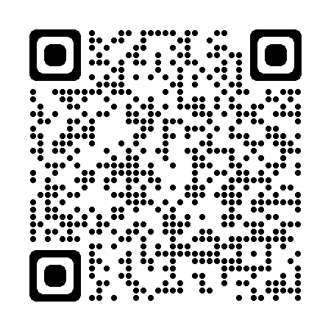
Public Input
Submit Questions and/or Comments:
by: Tuesday March 26, 2024
to:
Richard Sudmeier
FMG Engineering
3700 Sturgis Rd.
Rapid City, SD 57702
rsudmeier@fmgengineering.com
Public Meeting Information can be found at:
https://dot.sd.gov/projects-studies/projects/public-meetings#listItemLink_1971
Notes:
At this time, I will take any general comments or question you may have on this project. If you have any specific questions or comments regarding how the project may impact your property, we will take the remaining time to visit with you one on one at either one of the aerial layouts.
You are also asked to submit your questions or comments in writing on the form provided in the handout or via email address to [Insert Contact] by March 26, 2024.
In the next few days, the power point presentation, handout and design layouts will be added to the web site address noted. Go to the section under Pierre Region / Mobridge Area and click on the link to the project.

